Slide 1

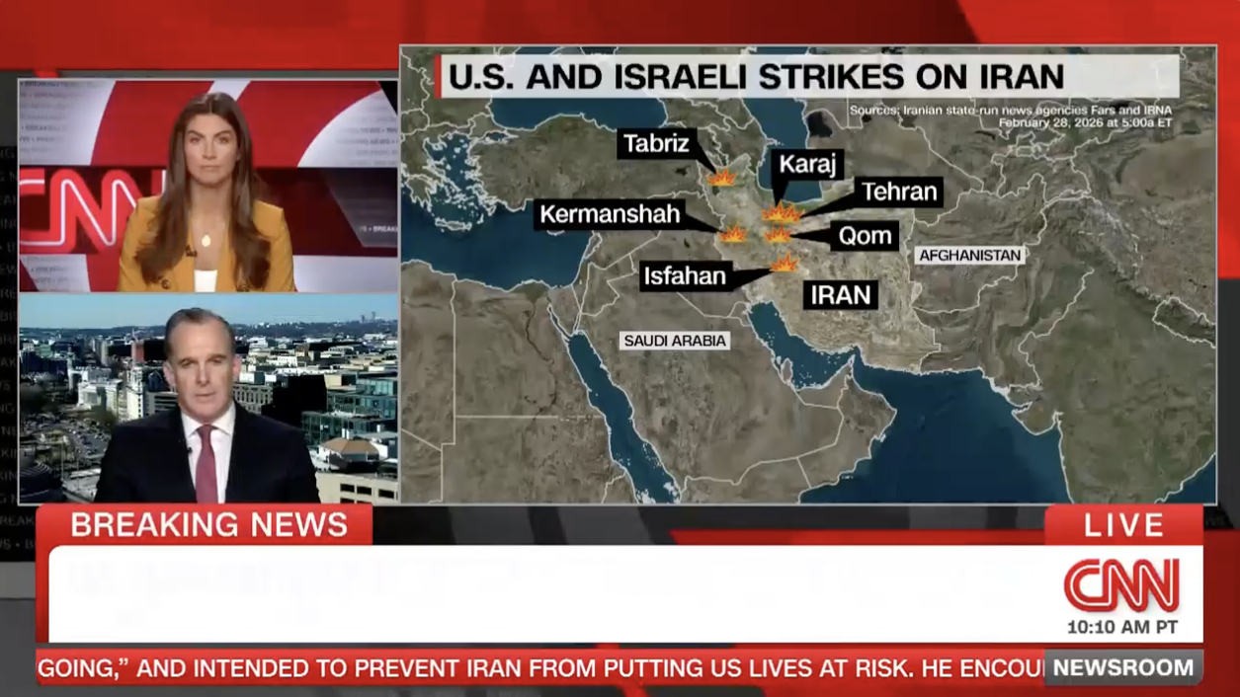
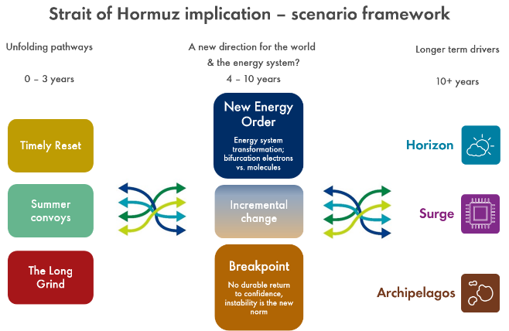
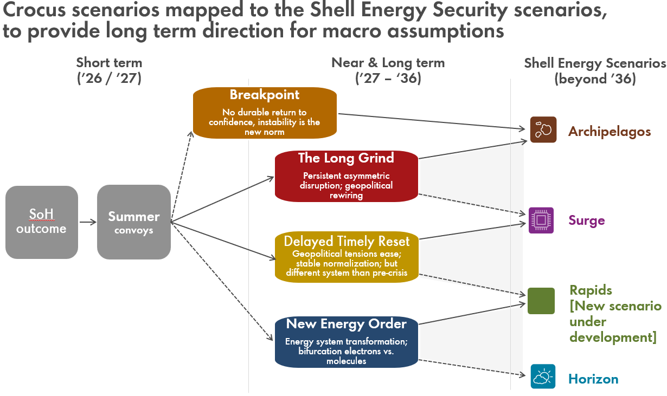
COLLABORATION & LEARNING
Crocus Scenarios
Supporting group crisis management, business planning and strategy stress testing during turbulent times
SHAPE
CONNECT
ACCELERATE
Olivier Kenter & Ana Duque Vallejo
SCA Global Team F2F 2026 | 7–8 September
One scenario set. One common language. Better decisions.
1
UNCERTAINTY
2
SHARED SCENARIOS
3
PLANNING DECISIONS
Geopolitical disruption makes a single forecast unreliable.
Four distinct futures expose where plans are robust—and where they break.
A shared language turns uncertainty into aligned action.
TIMELY RESET
Conditions for restored supply confidence
NEW ENERGY ORDER
Energy system transformation; bifurcation electrons vs. molecules
THE LONG GRIND
Persistent asymmetric disruption; geopolitical rewiring
BREAKPOINT
No durable return to confidence, instability is the new norm
CRISIS RESPONSE
Frame near-term decisions consistently.
MARKET ASSUMPTIONS
Align 2026 planning inputs across teams.
STRATEGY STRESS TESTS
Expose vulnerabilities before choices lock in.
One framework gives every team the same assumptions and vocabulary.
4
ENERGY SYSTEM IMPLICATIONS
5
INFORMING SHELL’s BUSINESS PLANNING
Leveraging Scenario capability
Common language & assumptions
Faster decisions with less rework
Shape. Connect. Accelerate.
September 7–8, 2026

